Slide 1
Higher Education policy in England: What has happened, where we are and where we are heading after the election
Jack Britton

Slide 2
Higher Education over the past 20 years
Before 1998
No tuition fees: funding for teaching through teaching grants
Mortgage-style maintenance loans
Maintenance grants available for the poorest students
1998-2005
Tuition fees of £1,200 introduced, with no loans but lots of fee waivers
Income contingent loans introduced for maintenance
Maintenance grants abolished
2006-2011
Near-trebling of fees to £3,000 in 2006, increasing with inflation
Income contingent loans for tuition fees introduced
Maintenance grants reintroduced

Slide 3
The 2012 reforms
Another near-trebling of tuition fee cap to £9,000 per year
Loans still income contingent, but important changes to the loan terms:
Increased repayment threshold to £21,000
Increased write-off period from 25 to 30 years
Increased interest rates from RPI + 0% to up to RPI +3%
Introduced National Scholarship Programme (NSP) to encourage access from poorest students

Slide 4
The impact of the 2012 reforms
For students
Not much change in cash in pockets while at university
Not much impact on applications either – though some evidence of a shift towards STEM subjects
For graduates
Big increases in repayments overall – concentrated amongst the wealthiest graduates
Nearly three-quarters expected to not clear in 30 years – like a graduate tax.
For universities
Much better off on average, but distributional changes
For government
Expected long run cost unchanged – though now way more uncertain.
Notes:
So what did all of this mean for students, graduates, universities and for government?

Slide 5
Impact on graduate repayments
Notes:
Link to this saying a big driver of high repayments is high interest rates.

Slide 6
Impact on graduate repayments
Notes:
Link to this saying a big driver of high repayments is high interest rates.

Slide 7
The impact of the 2012 reforms
For students
Not much change in cash in pockets while at university
Not much impact on applications either – though some evidence of a shift towards STEM subjects
For graduates
Big increases in repayments overall – concentrated amongst the wealthiest graduates
Nearly three-quarters expected to not clear in 30 years – like a graduate tax.
For government
Expected long run cost unchanged – though higher than expected (due to higher fees and sluggish earnings) and way more uncertain.
For universities
Much (more than 25%) better off on average, but distributional changes

Slide 8
Changes since 2012
The higher-than-expected government cost (plus generally squeezed public finances) have contributed to the following:
Removal of NSP
Removal of maintenance grants for poorest students (replaced with slightly larger loans).
Removal of bursaries for nursing and midwifery
Applications down by 23% - but places could still go up...
Freezing of the repayment threshold for five years
Affects repayments for all graduates except those always below the threshold, every year.
Impacts middle-earnings graduates the most.
Reduction in the discount rate to 0.7% +RPI, from 2.2% + RPI.
Increases valuation of repayments and hence the government asset.

Slide 9
Where we are now – student debt

Slide 10
Where we are now – student debt

Slide 11
Where we are now – graduate repayments
Notes:
Link to this saying a big driver of high repayments is high interest rates.

Slide 12
Where we are now – graduate repayments
Notes:
Link to this saying a big driver of high repayments is high interest rates.

Slide 13
Where we are now – graduate repayments
Notes:
Link to this saying a big driver of high repayments is high interest rates.

Slide 14
Where we are now – graduate repayments
Notes:
Link to this saying a big driver of high repayments is high interest rates.

Slide 15
Where we are now – graduate repayments
Notes:
Link to this saying a big driver of high repayments is high interest rates.

Slide 16
Where we are now
Vast majority – around 96% - of funding of undergraduate teaching is now through loans.
Dramatic reduction in teaching grants and flat fees results in big changes in university funding by subject:
Funding for Band A courses increased by 6% from 2011 to 2017, while equivalent increase for Band D is 47%.
This leaves little scope for targeting the subsidy to Higher Education
Goes to those with the lowest earnings.
Key economic rationale for a subsidy to Higher Education is “positive externalities” – big question about whether the current system does this efficiently

Slide 17
Where we are heading after the election
Conservatives
Primary focus on increasing competition
Removed student number cap and reduced restrictions for private providers.
Introduced TEF
Still plan to include international students as part of immigration statistics.
Liberal Democrats
Have promised to review the system (perhaps tweaking loan parameters)
Also promised “no more retrospective raising of rates, or selling-off of the loans to private companies”.

Slide 18
Where we are heading after the election
Labour
Scrap fees, bring back maintenance grants for the poorest students
Increase deficit by £11-£14 billion; more with student number growth and rising fees.
Long run impact smaller as some debt would have been written off anyway.
Wealthiest graduates benefit the most.
Big concerns about university finances
Allows more flexibility in spending
Also:
Repay all existing tuition fee debt from after 2012
d one off £30 billion to borrowing
Increase the debt by around £18 billion over the next 30 years
Exclude international students from immigration stats.

Slide 19
Where we are now – graduate repayments
Notes:
Link to this saying a big driver of high repayments is high interest rates.

Slide 20
Where we are now – graduate repayments
Notes:
Link to this saying a big driver of high repayments is high interest rates.

Slide 21
Where we are now – graduate repayments
Notes:
Link to this saying a big driver of high repayments is high interest rates.

Slide 22
Where we are heading after the election
Labour
Scrap fees, bring back maintenance grants for the poorest students
Increase deficit by £11-£14 billion; more with student number growth and rising fees.
Long run impact smaller as some debt would have been written off anyway.
Wealthiest graduates benefit the most.
Big concerns about university finances
Allows more flexibility in spending
Also proposed to:
Repay all existing tuition fee debt from after 2012
Add one off £30 billion to borrowing
Increase government debt by around £18 billion over the next 30 years
Exclude international students from immigration stats.

Slide 23
Summary
Major changes to the way Higher Education is funded over the last 20 years.
Was almost entirely grant-funded, now almost entirely funded through fees.
Students have to pay considerably more, although there doesn’t appear to have been a dramatic participation effect.
Universities have benefitted a lot – average funding per student now at its highest level in 30 years.
Conservative government will persevere with these changes, focussing on increasing competition.
We may see some large fee variation develop.
Labour’s plans would dramatically reverse the changes since 1998

Slide 24
Summary
More generally:
Huge question marks remain about Brexit.
The debate about international students will continue (UUK report highlighting significant economic impact)
Government has made fantastic strides from a research side, increasing linked data.
LEO data will provide fantastic new information for students and policymakers.
Still work to be done:
Linked UCAS data would be a game-changer
As would more information on the cost of provision for universities.

Slide 25
Thanks for listening

Slide 26
Access to HE: the applications gap

Slide 27
Access to HE: subject choices

Slide 28
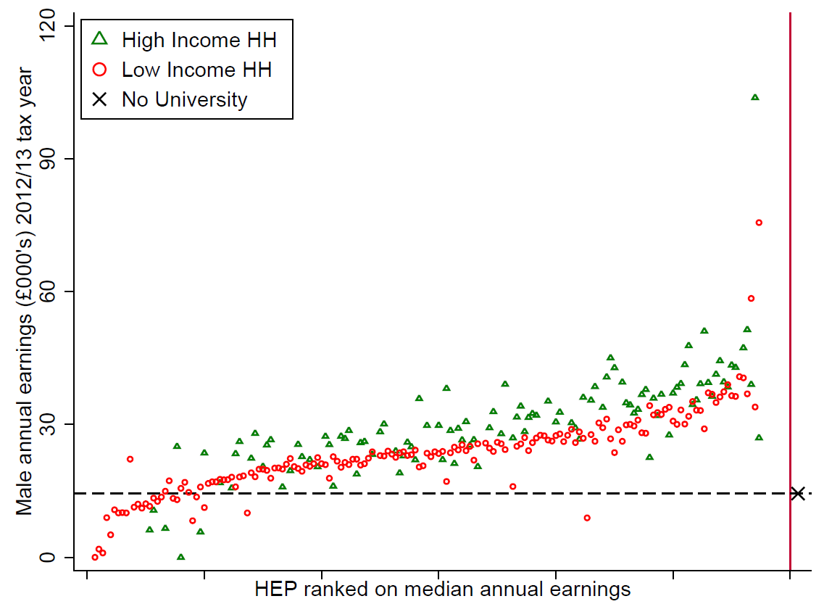
SES gaps in earnings

